Slide 1
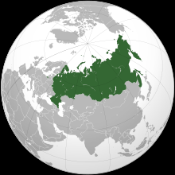

Undergraduate and Graduate Dual Degrees at Mason: Examples from Collaboration with Russia
Svetlana Filiatreau, Eurasia Programs Coordinator,
George Mason University
Office of Global and International Strategies
May 7, 2013
Where Innovation is Tradition
Notes:
Rita
Good Morning! I’m Rita Rowand…Ofc of Global Strategies. I’ve had the opportunity to travel to Russia twice on behalf of George Mason.
In this session we will explore the policies and cultural complexities that surround the development of academic collaboration with Russian universities.
Mason includes Russia in its strategic plan and takes advantage of its proximity to Washington DC to provide expertise in support of policymakers, scholars, and the international community.
Historically, interests and resulting partnerships initially emerged due to faculty connections. We have a constellation of Russian scholars in our university who were strong proponents for forging early partnerships. Through their development of strong ties between George Mason and some of the most preeminent universities in the Eurasian region, we have been able to collaborate and join together in conferences, guest lecture-ships, faculty exchange and other joint ventures. Earlier this year Mason hosted a Global Problem Solving Conference which included participants from the Higher School of Economics in Moscow.
Furthermore, Mason’s strong commitment to Russian language learning, which has been in existence for over 35 years with a related major, created a strong foundation for eventual partnerships and joint projects, of which we will elaborate more, later in the presentation. Please feel free to inject comments and questions throughout the presentation.
Today, I would like to introduce you to Ms. Svetlana Filiatreau, our Eurasian Coordinator in the Office of Global Strategies, who is a Ph. D. candidate doing research in …Ms. Richena Purnell Sayle, Manager of the Global Strategies Office, who traveled to Russia last summer for promotion of our Dual Degree program with Moscow State University, and Ms. Cheryl Choy, International MOU and Agreements Coordinator.

Slide 2
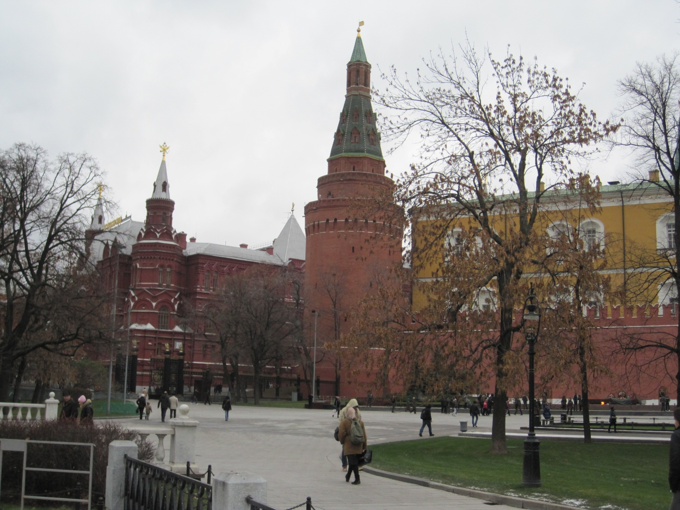
Notes:
What is this a picture of?? What is the relevance of it and what will we say? Perhaps we want to insert the map with universities? (#6)

Slide 3
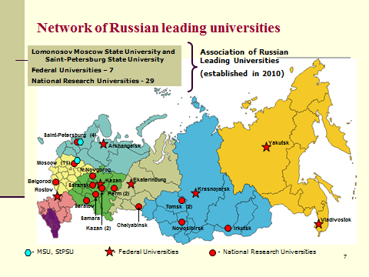

Slide 4
Higher education reforms
Bologna Process
  Bologna Process Reforms
    Ability to deliver 3 /4 + 2 education (Bachelor’s + Master’s)
    Transition from teaching-only university model to include research
New Law on Education – signed in November
  Focus on improving quality; innovation
  Implications for higher education institutions
    Examples
    Where Innovation is Tradition
Notes:
Svetlana
Examples – licensing and tightening controls –
Extra “points” for the following:
Requirements for increased quality and bonus points for faculty and administration’s professional development (extra points, if it is conducted abroad)
Increased focus and pressure to publish in peer reviewed publications in high ranked foreign publications – although the degree varies by institutions
Increased focus on providing students with global and international experience – either through traditional study abroad and exchanges (increased pressure on partner universities to come up with equal exchange options); short term programs, preferably for credit; global classrooms – live, simultaneous, technology-facilitated international classroom; depending on the type of the university, the focus maybe on the international research (even at the bachelor’s level);
Big push for sciences and engineering – tech transfer, from innovative research to innovative business ventures
Government facilitates creation of strategic investment avenues to create on the premises of universities innovative businesses (dramatically expediting research-to-market cycle).

Slide 5

Agreements with Partner Institutions
Moscow State University
St. Petersburg State University
Higher School of Economics
Summer & Winter Short Term Programs
Notes:
Rita
Russia has been on George Mason’s radar for quite some time.
With a strategic focus on the BRIC regions, Russia is an important area for us to turn our attentions.
Mason has TraCCC. The Terrorism, Transnational Crime and Corruption Center, which is part of our School of Public Policy. It studies organized crime and corruption, human trafficking, weapons smuggling and money laundering, illicit trade, drug trafficking and Environmental Crime. In 2012 TraCCC established a partnership with a Swiss NGO: Foundation for the World Anti-Illicit Traffic Organization, (WAITO) and now functions as the U.S. Bureau of WAITO.
2. Mason currently has Dual Degree programs with both Moscow State University, as an undergrad program in the disciplines of Economics and Management. We will elaborate on this program more in a moment. In 2006 we began discussions with the State University Higher School of Economics. We now have a Dual Degree program with them where students may obtain an M.A. in Economics from both institutions. Additionally we have implemented an International Executive Training Program on Real Estate Organization and Management, Development and Finance. Participants receive a Certificate in Real Estate Management. This program is not for academic credit.
3. And, we have a Student Exchange arrangement with St. Petersburg State University.
2. Short term programs have been designed for graduate and undergraduate students who want to participate in a customized program based on the students interests and fields of study, during the university’s winter break and summer session. Students receive a certificate of participation, but we are also exploring ways that they can receive credit at their respective institutions.
3. The Center for Eurasian Studies (CES) at George Mason University promotes the advancement of research, education, international collaboration, and local outreach in support of current and future scholars and students of the areas stretching from East Central Europe to Russia, Central Asia and the Caucasus.

Slide 6
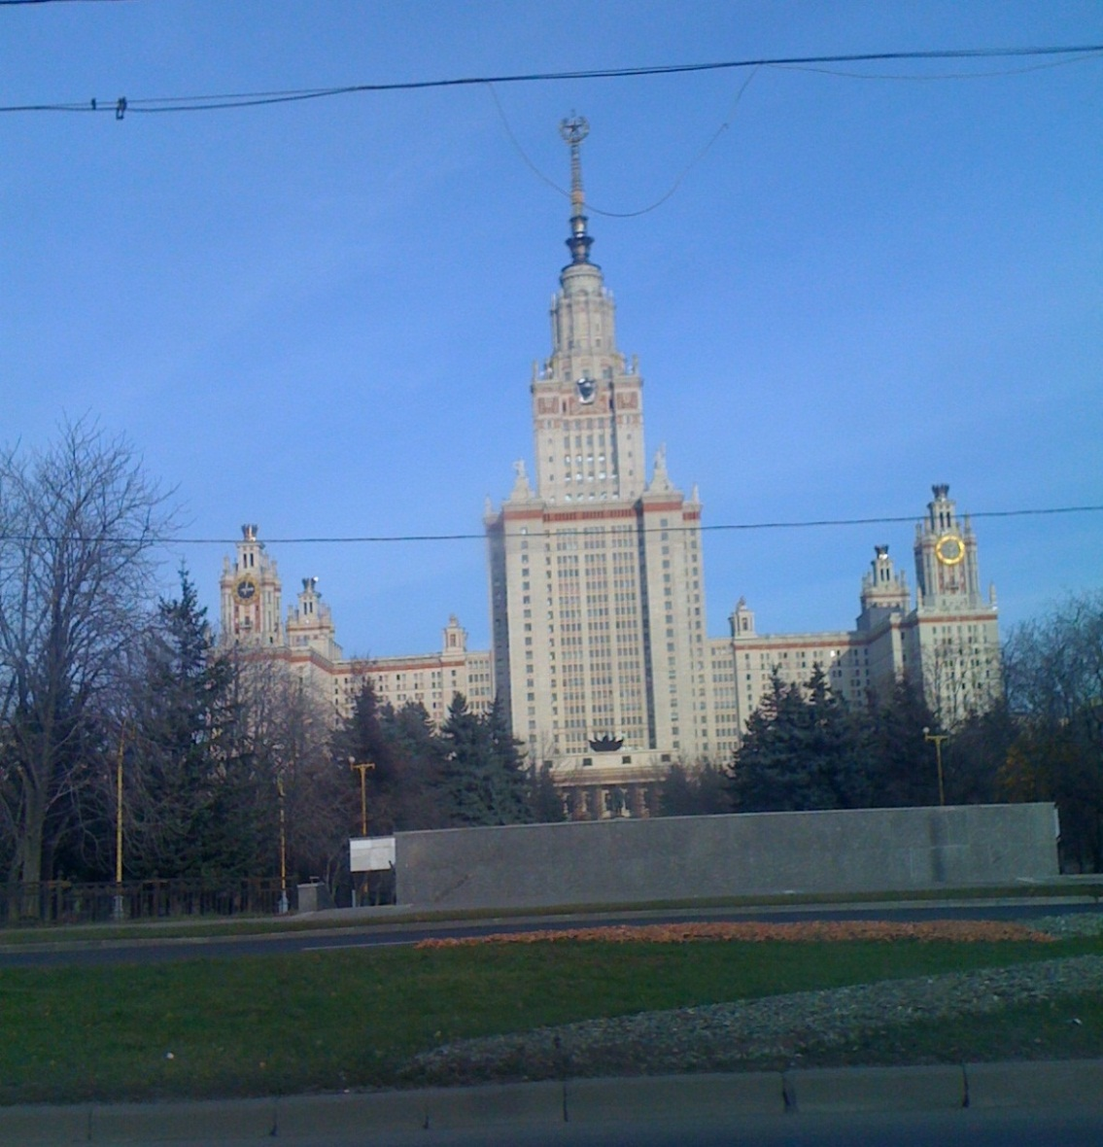
Sample Partnership
Lomonosov Moscow State University
Notes:
Svetlana
In 2008, George Mason University began planning a dual degree program in partnership with Moscow State University’s Economics Department.
Students enrolled in this program will receive degrees from two institutions, one from GMU and one from MSU, Russia’s leading institution of higher education.
Undergraduate degrees are offered with majors in Economics or Management. Students begin their undergraduate studies in MSU and apply in the fall of their freshman year to come to Mason in their sophomore year. Upon arrival to Mason, students spend their second year in classes taught by MSU faculty, while improving their English skills through ELI. In the third and the fourth year, the students enroll into classes in their specific majors taught by GMU faculty. To date, two cohorts of students are enrolled in the program.
Due to the need to increase program participants, there will not be a new cohort until Fall 2013.

Slide 7
Sample Curriculum Layout for Dual Master’s
Moscow State University Political Science – GMU Political Science
Moscow State University Political Science – GMU Public Administration

Slide 8
Undergraduate Dual Degree in Economics and Management
Program Structure
Program Students
  Student body composition in MSU Economics Department
  Students entering MSU-GMU Dual Degree program
Program Faculty
  Education levels and income disparities
  Holding 2-4 full-time teaching appointments
Notes:
Svetlana
Program Students
Student body composition in MSU Economics Department
Students entering MSU-GMU Dual Degree program
Program Faculty
Education levels and income disparities
Holding 2-4 full time teaching appointments

Slide 9
Marketing for Mason / Moscow State University
Dual Degree Program
Important structural/cultural differences:
MSU’s admissions structure
Academic timetable
Paper driven
Parental involvement levels
Notes:
Richena
I’m going to give you a quick overview on how we handle marketing for the Mason/MSU Dual degree program. The dual degree program is structured to have one coordinator from Mason (Svetlana) and another from Moscow. It is important to note that this program is only one of many responsibilities of each coordinator, so various aspects of the program are designated to a few other people throughout the office at any given time. Mason made a commitment to recruit in Moscow, in person, twice a year. Rita and I traveled to Moscow in June 2011. For the trip, we prepared brochures in Russian about the program including details on structure of program, cost, and information on the Washington region. We stayed in MSU’s historical main building in rooms organized by our partners.
Before I describe the hits and misses of the trip I would like to paint a picture for you of the typical admissions process at MSU (and other Russian universities) and how we fit into it.
High school students in Russia graduate in mid June, then take the “Unified State Exam” which is an SAT- style independent examination. They then have 2-3 weeks to apply (typically in person) to their top choice universities.
At MSU, as in many European schools, each department handles their own undergraduate admission. Particular professors are designated to be admissions counselors or the director during admissions critical times of the year.
The MSU admissions process is still largely paper driven so students arrive with bundles of academic scores and personal information. Besides taking a standardized test to graduate, they take a separate admissions test at most universities, usually as part of the in-person application process.
In Russia, parents often lead the admissions process, arriving to apply with their children and manage the application information. For example, many parents talked to us about the dual Degree Program and asked for details even when their children were clearly not interested. We have found that this direct involvement continues when the students enter college and throughout their university tenure. Even when the students come here, their parents take an active role in their daily lives and expect us to do so as well.

Slide 10
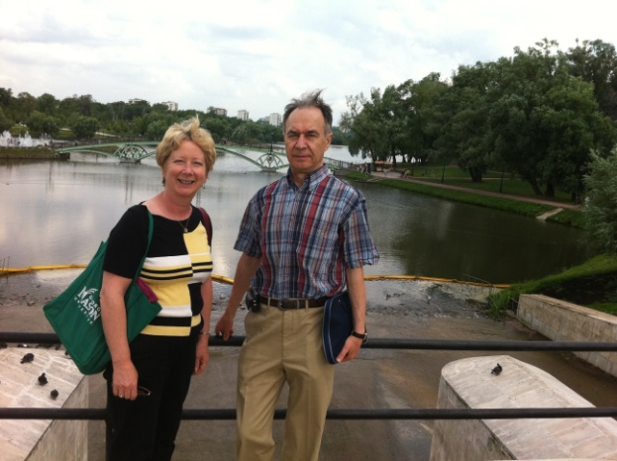
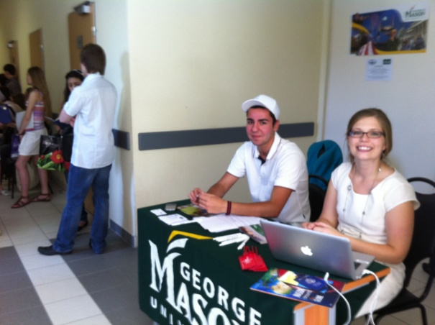
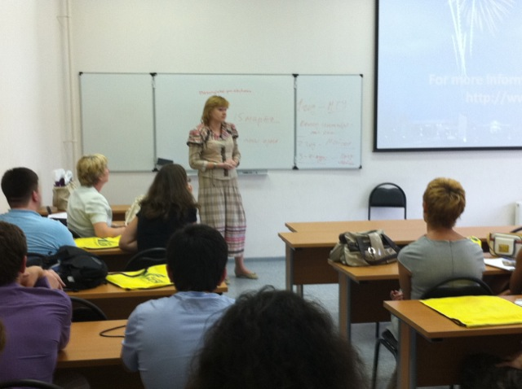
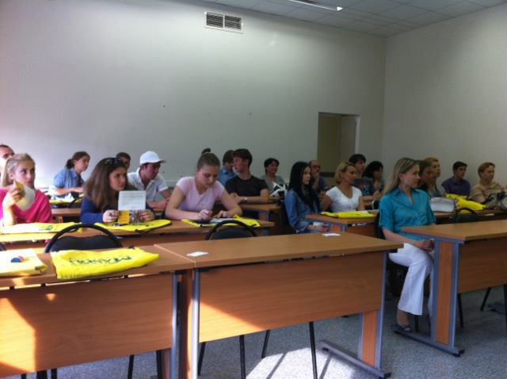
Recruiting trip for Dual Degree Program, Summer 2011
Wins
Misses
Richena at the info table with current dual degree student
Rita with MSU professor
Information session lead by coordinators and professors
Notes:
Richena
We were there during 2 of the 3 application weeks. Every day from 9-4 we were stationed in an entrance to intercept students who were on their way to apply to MSU in order to tell them about the dual degree program. (Our placement and working hours were also at the request of our partner.)
I will describe our work in the terms of wins and losses. The wins are the strategies we hope to repeat and losses are the things we hope to improve upon.
Wins:
-We had a good team member mix for this trip of familiar and new faces. Rita had been there once before and this was my first trip.
-As the returning Mason staff member, Rita had developed friendly relationships with the MSU faculty who teach in the program. They shared information with us and were excellent and reliable hosts. I believe that without Rita’s well cared for connections that trip would have been more rocky and a lot less productive.
-We co-hosted two information sessions with the MSU coordinator. In addition to our presentations, the professors who teach in the program spoke to the students about the Mason campus, their experiences and their classroom style. The professors enjoy teaching in the program because their classes are much smaller and more flexible then their traditional theatre style classes in Moscow. The professors came to these information sessions voluntarily and worked it out among themselves to make sure they were represented at each session. This is important because professors at Moscow state University are highly respected by the students so it is really their participation and opinion about the dual degree program that matters most.
-We brought fresh marketing material with up to date information and pictures of current students.
Misses:
-The timing of our trip was not ideal. Although the set-up during application days led to large student exposure, many of the students were not qualified for the program as they did not get accepted into MSU. I believe that the timing was premature as students were not ready to make this level of commitment. Since they were taking exams while applying, most of the students were preoccupied over the test and other application stresses. It is important to note that MSU is a premiere institution in Russia with very competitive openings which makes the pressure even higher. Our presence was a good advertisement for MSU to attract the best students. A Better option would be to recruit at the beginning of the student’s freshman semester, in September.
-The Hallway information booth turned into an information kiosk for directions. It would be better to give focused presentations to interested students rather then information booth style recruiting.
-Did not have dedicated student translators posted at the table. This caused some frustration on both the part of the parent/student groups and for us. We also believe it challenged our credibility to some extent.

Slide 11
Part I – The eMOU Process
Originator submits Notification of Intent (NOI)
Dean’s Review
Provost’s Review
Evaluation for alignment with strategic objectives.
Approval authorizes further exploration of the project.
Originator receives email with notification of status and directions to MOU templates
Start Part II:
MOU /Agreement development process
If denied: originator receives email notification of Dean’s decision
If denied: originator receives email notification of Provost’s decision
Notes:
Cheryl
Why have this? How did it originate?

Slide 12
Part II – The MOU Development Process
Agreement Development
Originator uses templates and works with partner to develop agreement
Administrative Evaluation
Originator submits draft agreement to Agreement Administrator for review by MOU Committee
Agreement Revision
If revision is needed, originator produces final document; submits to Agreement Administrator
Verification, Final Approval, and Signature
Agreement Administrator verifies changes with MOU Committee members as needed, obtains signatures and return Agreement to originator for partner’s signatures
Agreement Maintenance
Agreement is stored in database.
An alert will be sent when the Agreement is due for renewal
If Agreement includes joint or dual degrees, ongoing discussion with
Office of Academic Affairs, Registrar’s Office, Office of the Assoc. Provost for Graduate or Undergraduate Education, Office of Admissions, Office of Financial Aid, and Office of Student Accounts prior to drafting Agreement is expected.
Notes:
Cheryl

Slide 13
International Collaboration: Public Diplomacy in Every Way
Partner institutions and country politics
  Relationships matter
    Personal, political, and present and past affiliations of the in-country partners
    Your faculty’s research and personal networks in the country
  Example of Mason’s relationships in the context of the US public diplomacy context
US educational organizations with in-country operations
  Education USA
  American Councils
  US Embassy
  US Russia Business Council
Notes:
Svetlana
Through these networks, we will most likely change the program structure and recruit students from other universities and high schools; we will also build new collaborative partnerships – i.e. with federal universities.
Dr. Baranova’s research and networks in the context of the country’s focus on research and innovation (international collaboration plays a key role);
Dr. Mamij => Dr. Veduta =>FGU and its personalities and future projects with the unit…

Slide 14
Philosophy of Building Parterships
Invest in relationships
Build trust through dialogue
Invest in educating both sides in specifics of each other’s culture
Keep informed about multiple levels of your partner’s fast changing country and institutional context
Understand and respect institutional and individual’s self-Interest and internal processes
Agree to disagree
Help organizations to achieve their self-Interest
Exercise patience and openness to serendipitous opportunities
Notes:
Svetlana
Dialogical (Freire) nature of partnership development;
I may disagree with how things are handled – but I have little or no control; Instead, when I listen and sincerely try to understand the other side, I may have a better idea on how to go around the issue or have and insight about an alternative way.
Invest in relationships
Time
Authentic care
Understand your partner institution’s and individual leaders’ and faculty context
Political
Economic
Build trust through dialogue
Invest in educating both sides in specifics of each other’s culture
Keep informed about multiple levels of your partner’s fast changing country and institutional context
Understand and respect institutional and individual’s self-Interest and internal processes
Agree to disagree
Help organizations to achieve their self-Interest
Exercise patience and openness to serendipitous opportunities

Slide 15
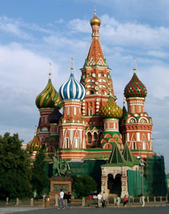
Thank you for your attention!
Questions?
Office of Global Strategies
masonglobal@gmu.edu

